Slide 1
Satellite rainfall application in the Narayani basin CORDEX South Asia science workshop Kathmandu, Nepal 27-30th August 2013
Mandira Singh Shrestha

Slide 2
Presentation outline
Satellite rainfall estimates
Hydrological modelling using GeoSFM
Study area
Input data
Intercomparison of products
Calibration and validation
Results

Slide 3
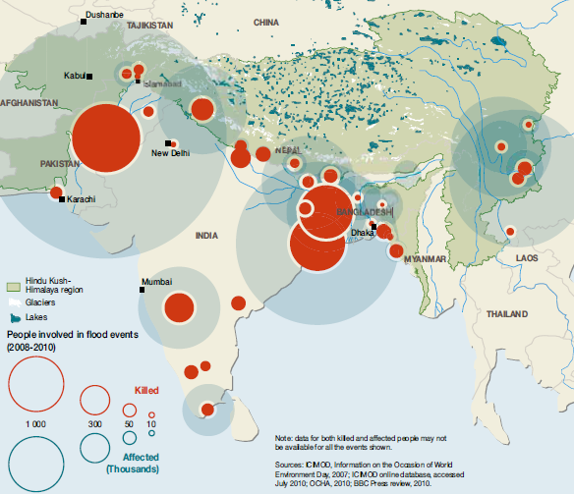
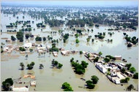
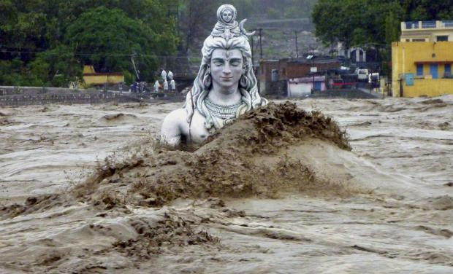
One third of the disaster are floods
Pakistan floods: 2000 killed, 20 million affected
Most floods are transboundary which requires cooperation across borders
Uttarakhand disaster:
>5000 killed, millions affected

Slide 4
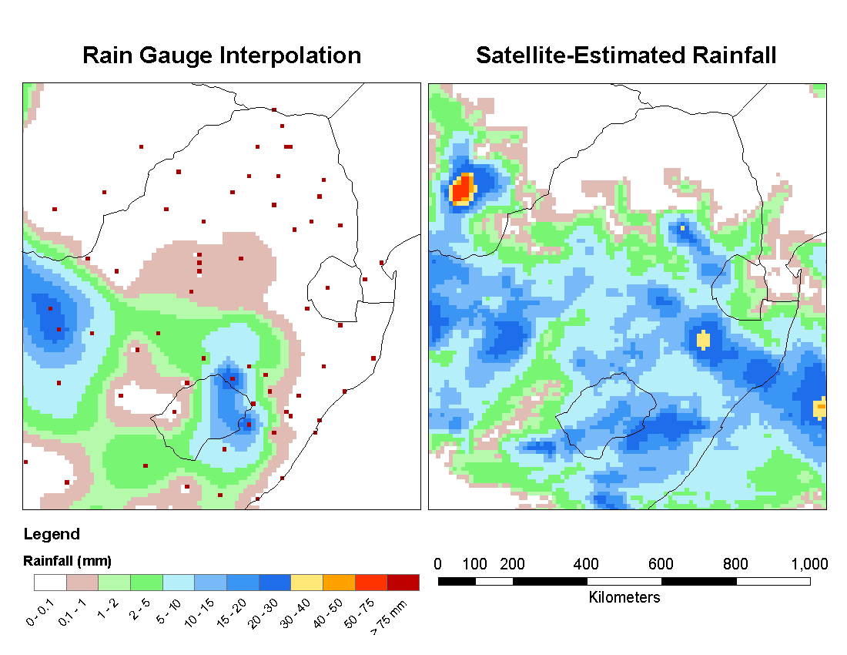
Why satellite rainfall estimate?
Inadequate density of hydrometeorological stations
Delay in data transmission
Not adequate lead time – limited data sharing across transboundary borders
Failure to Capture
Significant Rainfall

Slide 5
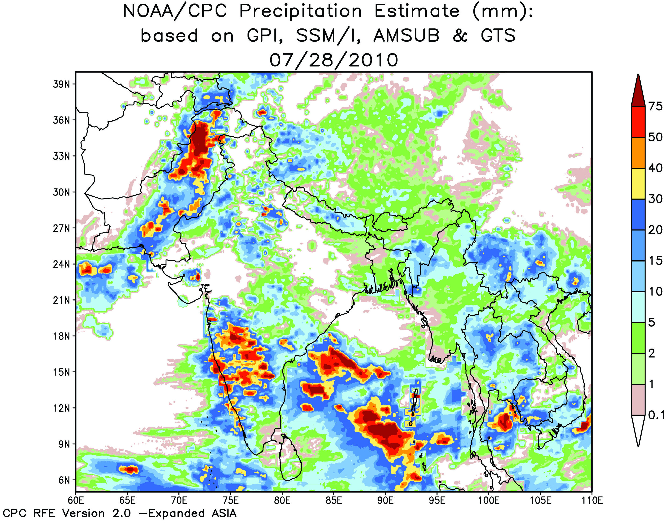
Application of satellite-based rainfall estimates
Objective 1: Assess the accuracy of satellite-based rainfall estimates and make intercomparisons
Objective 2:Applying the satellite-based rainfall estimates for flood prediction and integration of snow and glacier into rainfall runoff modelling

Slide 6
Satellite - based rainfall estimate: NOAA CPC-RFE2.0
Initial version became operational in January 2001
Originally run over the African continent then expanded to southern Asia and western Asia / eastern Europe
Product is a combination of surface and satellite precipitation information
Spatial resolution: 0.1 degree
Temporal resolution: daily
Domain: 5º to 40ºN, 60º to 110ºE

Slide 7
Methodology for verification of satellite-based rainfall estimates

Slide 8
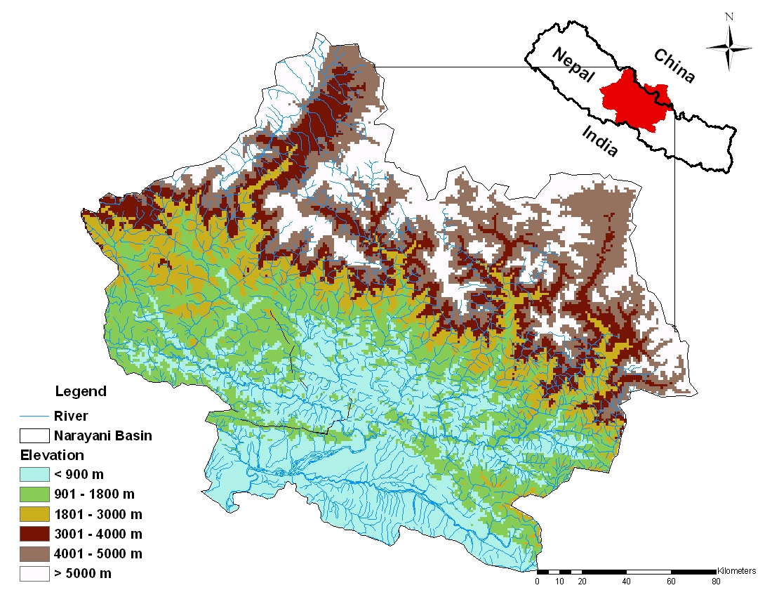
Study area: Narayani basin
Basin characteristics:
Located in central Nepal
Catchment area = 32, 000 km²
Elevation variation 8167-100 m
More than 70% of rainfall occurs in monsoon
High spatial and temporal variation of precipitation
200 mm – 6000 mm

Slide 9
Study area and hydrometeorological network

Slide 10
Input data
Spatial datasets
Digital Elevation Model: Hydro 1k DEM
Soil data (FAO)
Landcover (USGS)
Dynamic datasets (daily time series)
Satellite rainfall estimates: NOAA CPC_RFE2.0 rainfall estimates
Period: 2003 – 2004
Gauge observed rainfall (DHM)
Discharge data – period of record 1964-2006 (DHM)

Slide 11
Rainfall bias: Narayani

Slide 12
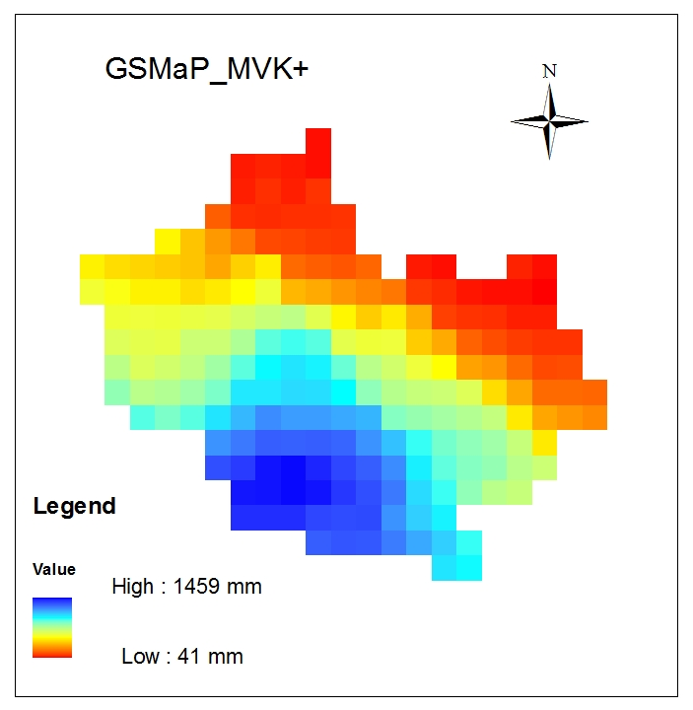
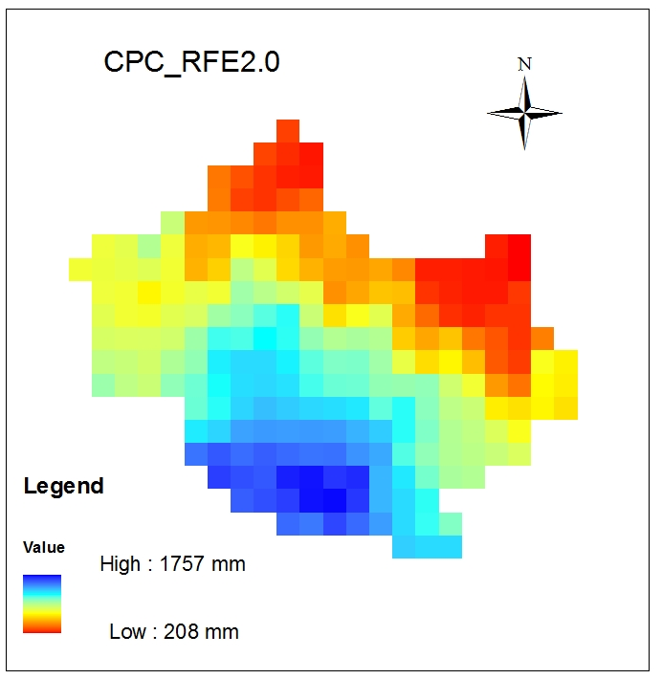
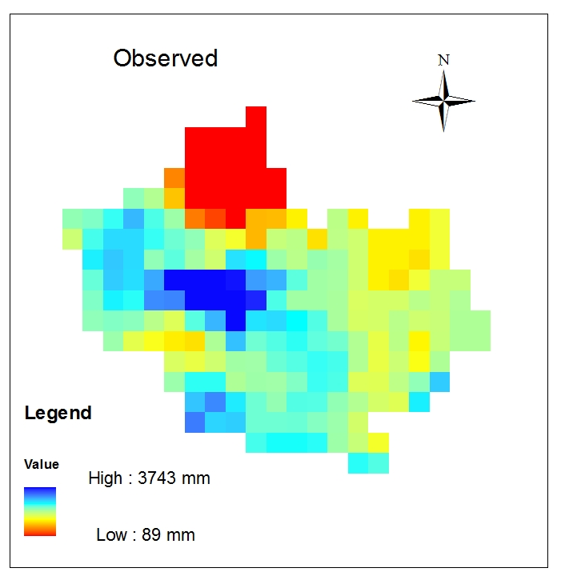
Intercomparison
Accumulated June, July, August and September rainfall for 2003

Slide 13
Comparison of annual rainfall

Slide 14
GeoSFM model overview
GeoSFM simulates the dynamics of runoff processes by using remotely sensed and widely available global datasets
Catchment scale modeling framework
Semi-distributed hydrologic model
Inputs aggregated to the catchment level
GIS based Modeling
ArcView 3.0 environment

Slide 15
GeoSFM model framework
Semi distributed
hydrologic model
Outputs
Discharge
Soil moisture
Hydrologic simulation
Terrain analysis
Basin characteristics
Basin response
Soil water balance
Streamflow generation
Inputs
Precipitation
PET
Semi-distributed, physically based hydrologic model
Simulates runoff process using remotely sensed data and global datasets
Graphical user interface within GIS for model input and visualization (ArcView version 3.x with the Spatial Analyst Extension)
Spatial information database
DEM, Soil, Landcover

Slide 16
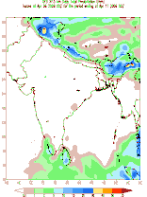
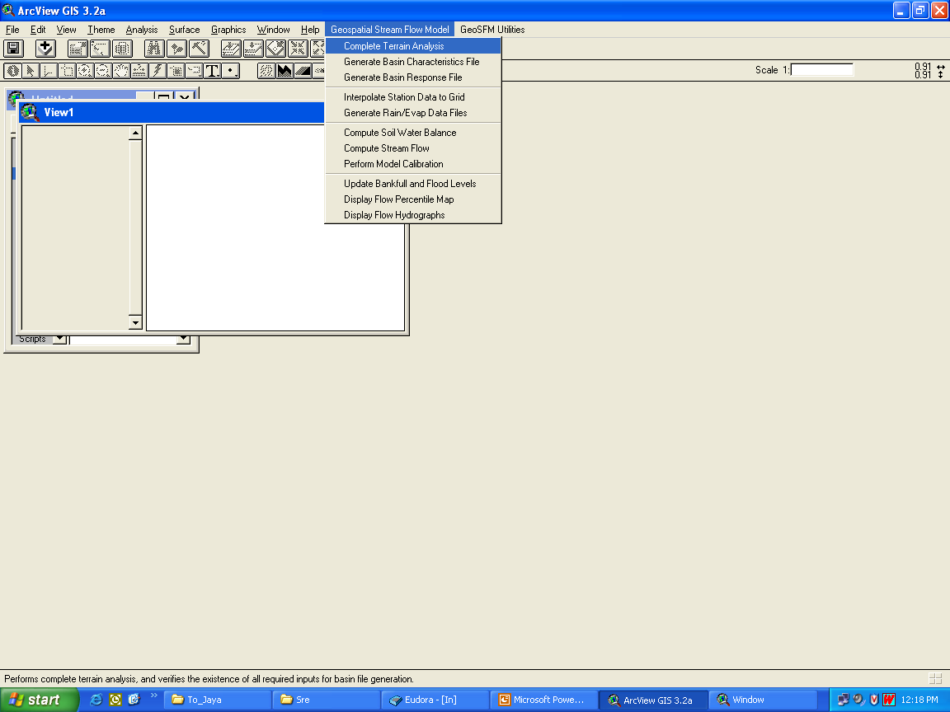
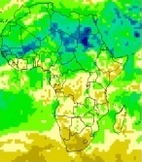
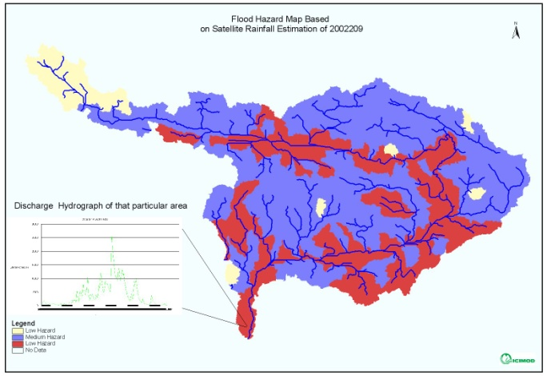
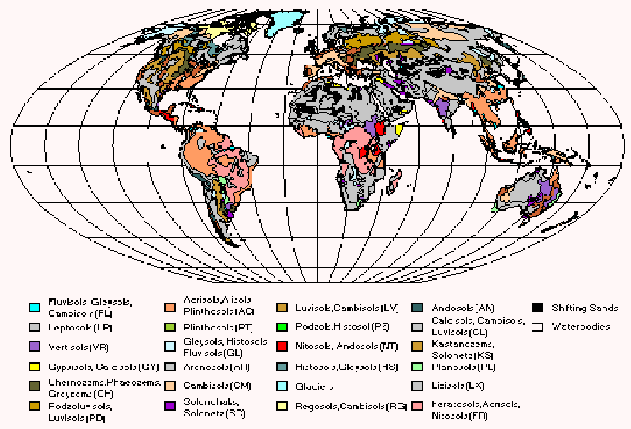
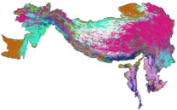
GeoSpatial streamflow modelling for flood risk monitoring
GIS Preprocessing
Processing and Analyzing
Satellite
Rainfall Estimates
GDAS PET Fields
FAO Soil Data
Land Use/ Land Cover
DEM

Slide 17
Geospatial Stream Flow Model (GeoSFM))
Water Balance
Routing
1D
2D
Sub-basin 1
+
Sub-basin 2
Main channel
Sub-basin 3
+
Sub-basin 4
Main channel
Subbasins are the modeling units for water balance and routing
Muskingum-Cunge
Diffusion
Lag
+
Outlet
GeoSFM rainfall-runoff component has three main modules: water balance, catchment routing, and distributed channel routing
Source: Guleid Artan

Slide 18
Model components
Terrain analysis module
Parameter estimation module
Data preprocessing module
Water balance module
Flow routing module
Post-processing module

Slide 19
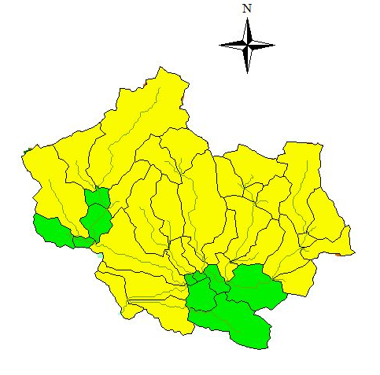
GeoSFM modelling
39 subbasins were considered
Hydro 1K DEM - hydrologic parameters, such as slope, aspect, flow direction, and accumulation were derived
focused in particular on the months of June, July, August, and September (the monsoon season)
gridded gauge observed rainfall data for the monsoons of 2003 and 2004 were used in the GeoSFM to predict floods

Slide 20
Model performance indicator
Nash Sutcliff Coefficient of Efficiency (NSCE)
where O_{i} is observed discharge, S_{i} is simulated discharge, and is the mean value of the observed discharge.

Slide 21
Model calibration and validation
Observed and simulated streamflow at Devghat using 2003 monsoon gauge observed rainfall (June to September) NSCE = 0.84, Correlation = 0.94
Observed and simulated streamflow at Devghat using 2004 monsoon gauge observed rainfall (June to September) NSCE =0.77, Correlation 0.94

Slide 22
Comparison of observed and simulated with CPC_RFE
Comparison of observed and simulated daily flows at Devghat using gauge observed rainfall and RFE data as input rainfall (June to September 2003)

Slide 23
Why bias-correction?
Regional and country level satellite-based rainfall estimates have indicated discrepancies between SRE and gauge observed rainfall
The uncertainty involved in Geo-SFM modeling that has been observed using the SRE
Bring observed and predicted/estimated values as close to each other as possible
The bias in precipitation was found to vary spatially in a given domain/basin

Slide 24
Methods of bias-adjustment
Ratio based or multiplicative bias-adjustment
Ingestion of local rain gauges into the RFE algorithm
Anomaly – based bias adjustment
Correcting the mean and coefficient of variation
Many other methods

Slide 25
RFE and improved RFE: Narayani basin
Basin averaged RFE
Basin averaged Improved RFE

Slide 26
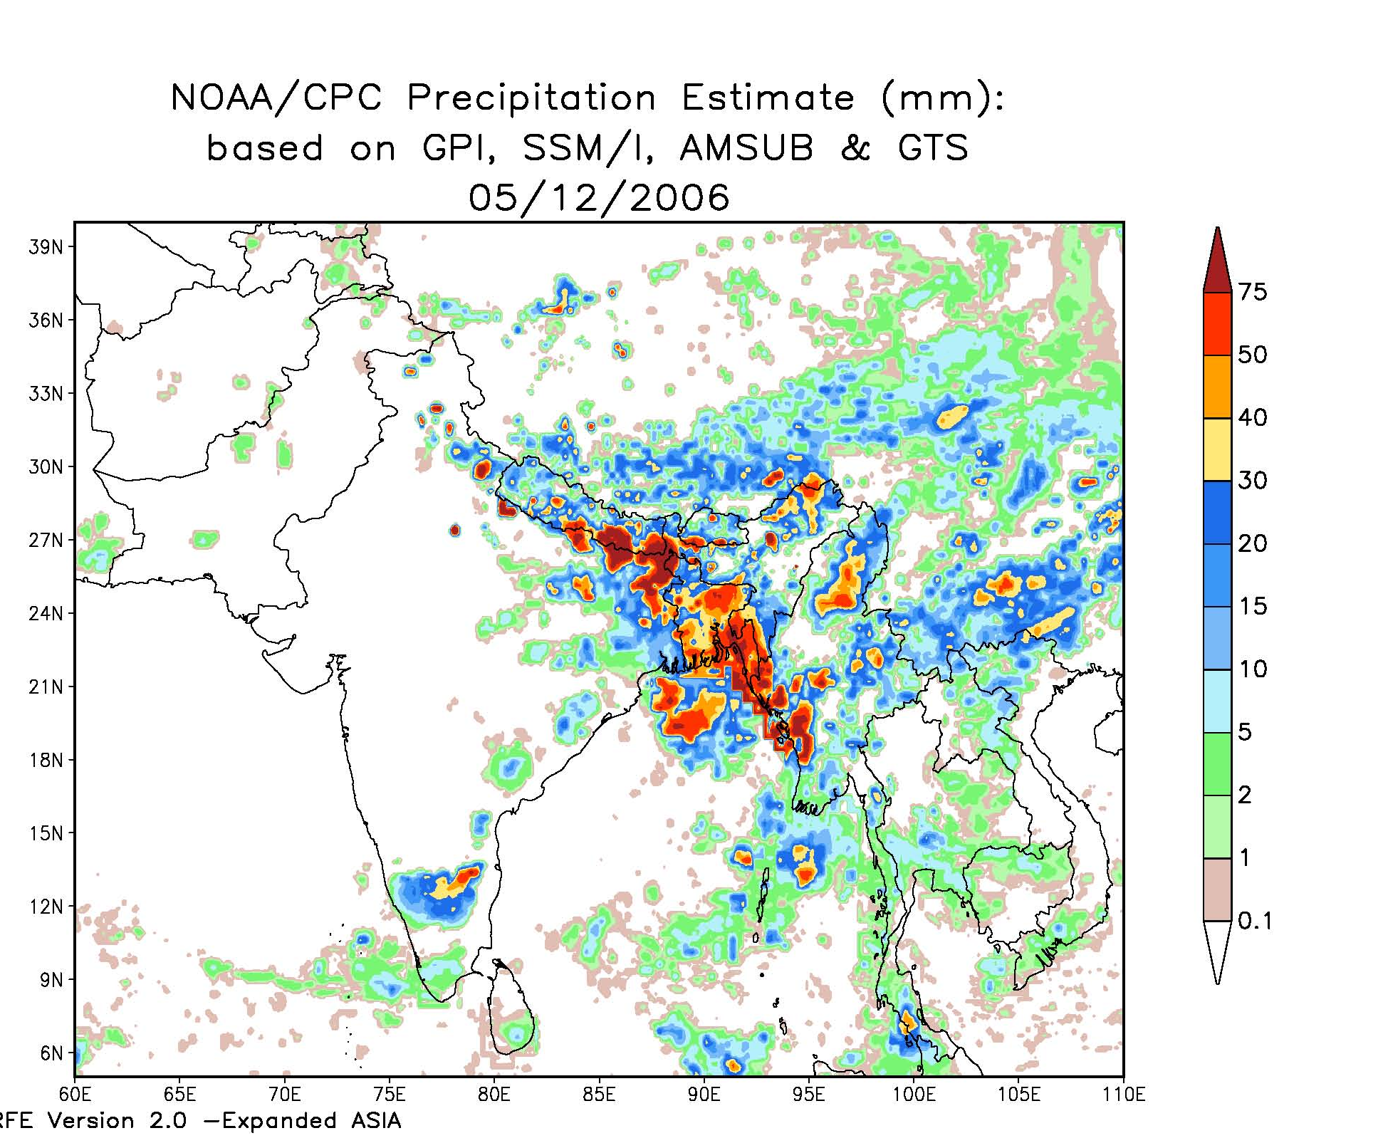
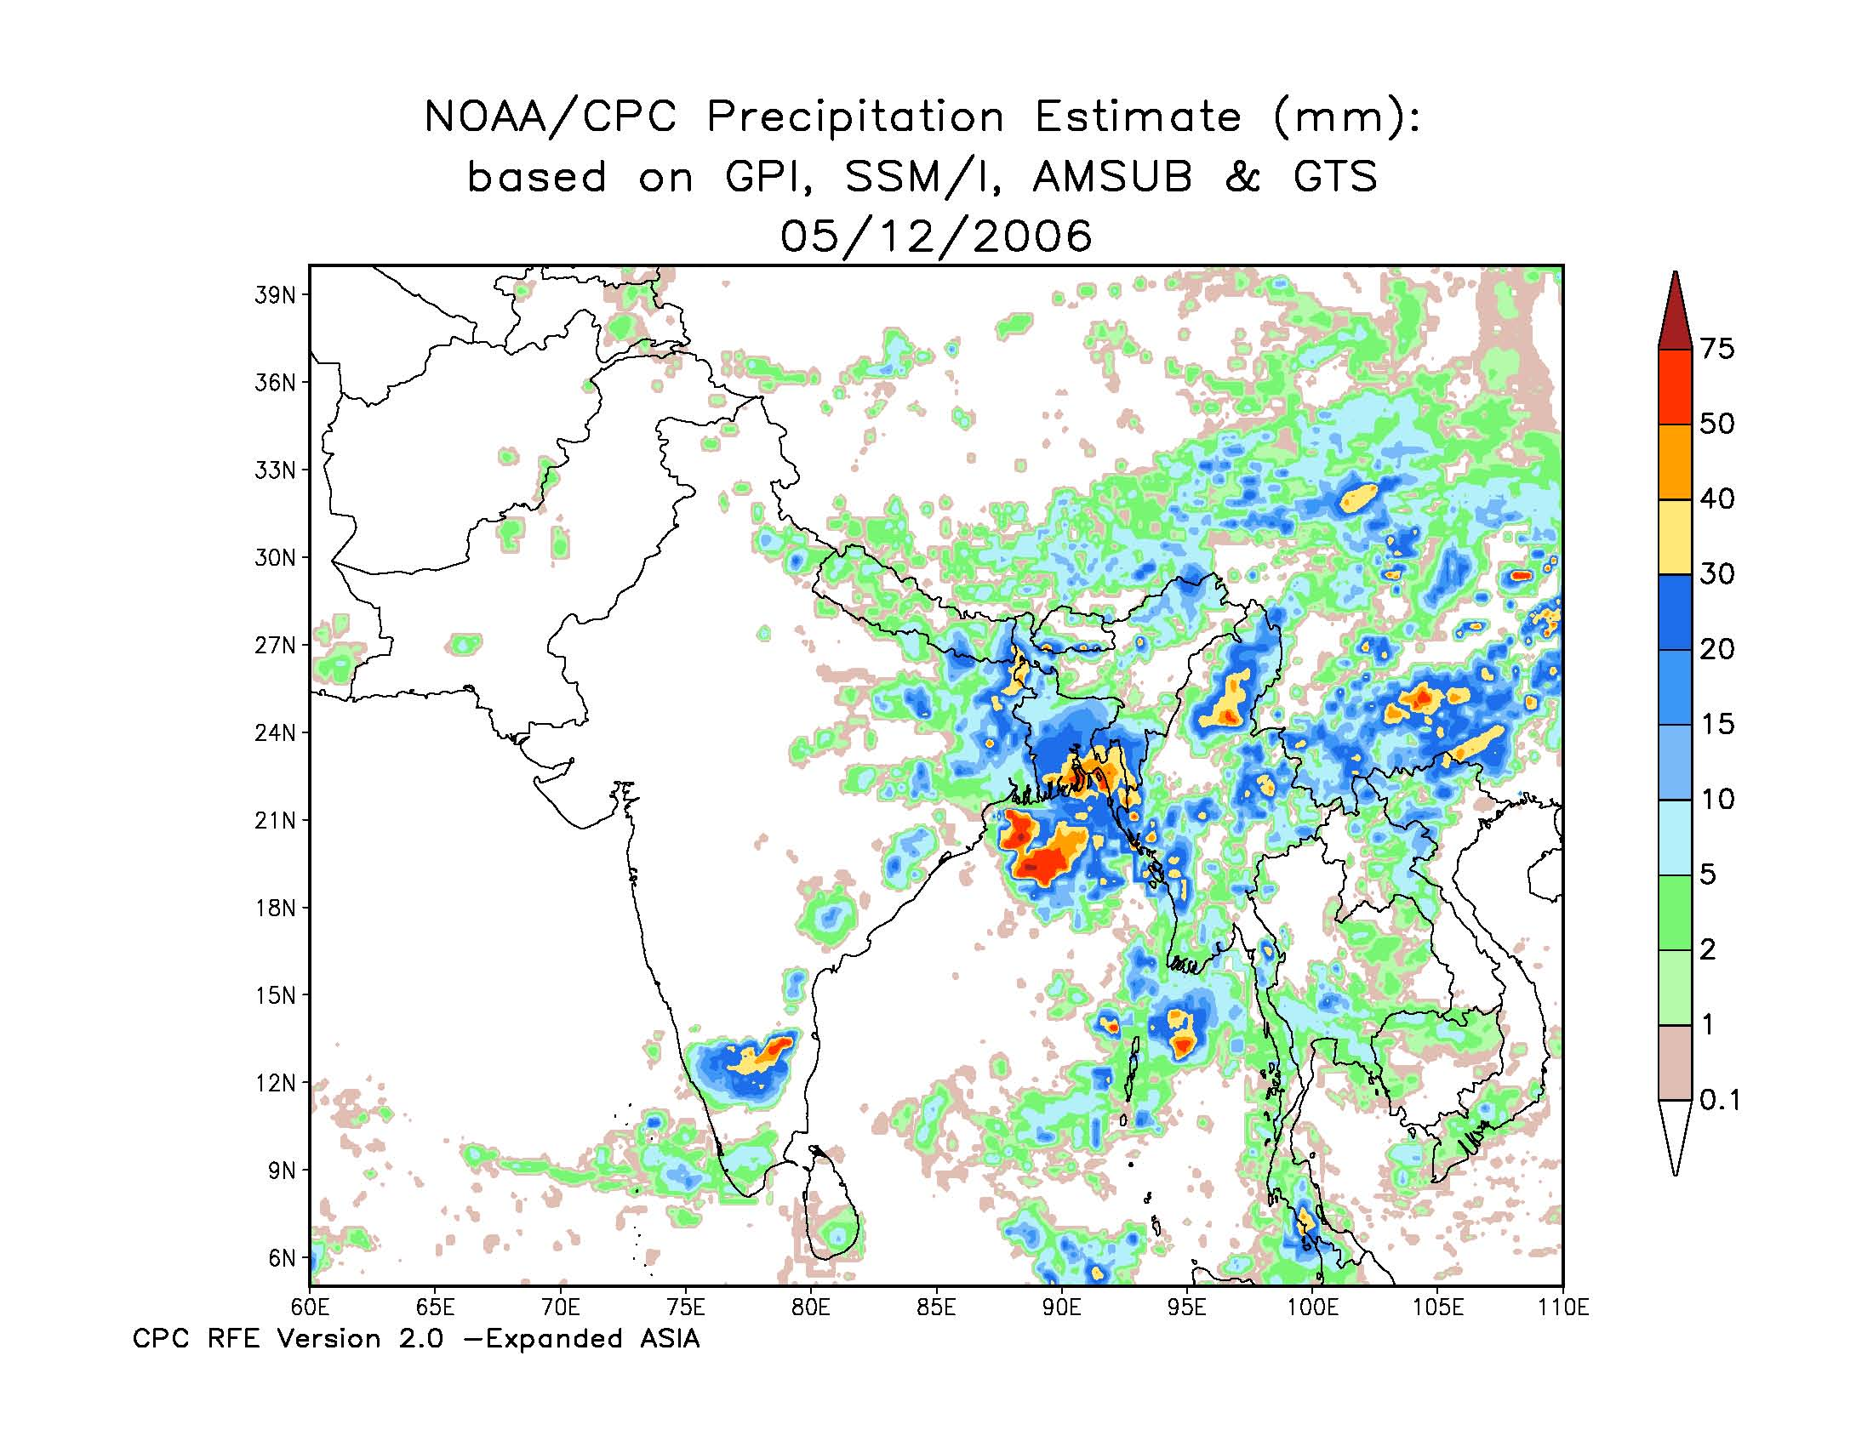
Improved RFE
RFE-the shape of precipitation is given by the combination of satellite estimates, magnitude is inferred from GTS station data, need the maximum availability of the rain gauge stations - Incorporate more gauge data for improved rainfall estimates

Slide 27
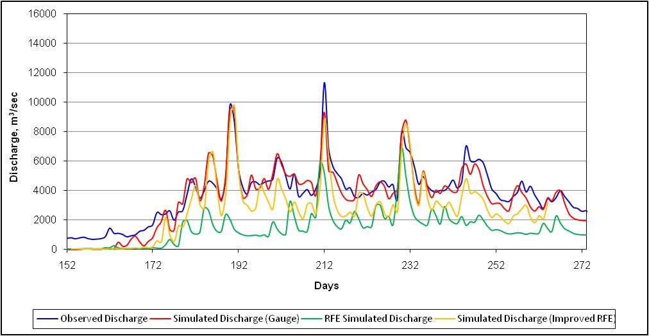
Rainfall ingestion: Narayani basin

Slide 28
Statistical comparison of performance of GeoSFM with unadjusted and adjusted RFE

Slide 29
Daily observed and simulated flows using bias-adjusted CPC_RFE2.0 rainfall
Shrestha, M.S., Artan, G.A.,Bajracharya, S.R., Gautam, D.K. and Tokar, S.A. (2011) Bias-adjusted satellite-based rainfall estimates for predicting floods: Narayani Basin. J. Flood Risk Management

Slide 30
Summary
Using new technology and advanced scientific knowledge for monitoring, assessing, forecasting and communicating information
Data formats are important as data preparation takes a lot of time and energy
Good quality insitu data is essential for model calibration and validation
Improved understanding of flood forecasting methods and models
More accurate (quantitative) and high resolution data are necessary for reasonable flood predictions. It is difficult to predict the floods quantitatively using current satellite based data. We can only give an indication of probability of occurrence
Intercomparison of satellite based rainfall estimates and models for flood forecasting needs to be further explored.
Continued training and capacity building in state of the art technology such as application of satellite-based precipitation in the region is necessary to enhance flood risk management.

Slide 31


